Slide 1
THROMBOCYTOPENİA
Jose N Galeas MD

Slide 2
Definition
Normal platelet count: 150,000-450,000/microL. Thrombocytopenia is decreased platelet count below normal.
Classification: - Mild: 100,000 - 150,000/µL - Moderate: 50,000 - 99,000/µL - Severe: <50,000/µL
Surgical bleeding usually does not occur until the platelet count is less than 50,000, and spontaneous bleeding does not occur until the platelet count is less than 10,000-20,000.

Slide 3
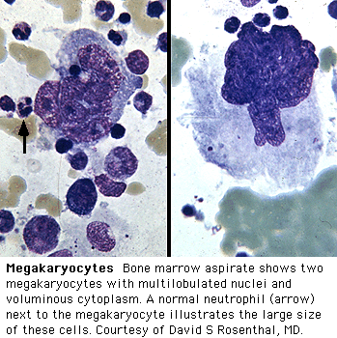
Platelets
Platelets are produced in bone marrow from Megakaryocytes
An estimated 1000-5000 platelets are produced from each Megakaryocyte
In normal adults platelet production is ~35,000-50,000/microL of whole blood per day. This value can be increased 8-fold during times of increased demand

Slide 4
Clinical picture
Regardless of cause, severe thrombocytopenia results in a typical pattern of bleeding:
multiple petechiae in the skin, often most evident on the lower legs;
scattered small ecchymoses at sites of minor trauma;
mucosal bleeding (epistaxis, bleeding in the GI and GU tracts, vaginal bleeding); and
excessive bleeding after surgery. Heavy GI bleeding and bleeding into the CNS may be life threatening.

Slide 5
Signs and Symptoms
• Common Symptoms:
- Petechiae, purpura
- Mucosal bleeding (gums, nose)
- Easy bruising
- Heavy menstrual bleeding
• Severe Symptoms:
- Intracranial hemorrhage
- Gastrointestinal bleeding
- Hematuria

Slide 6
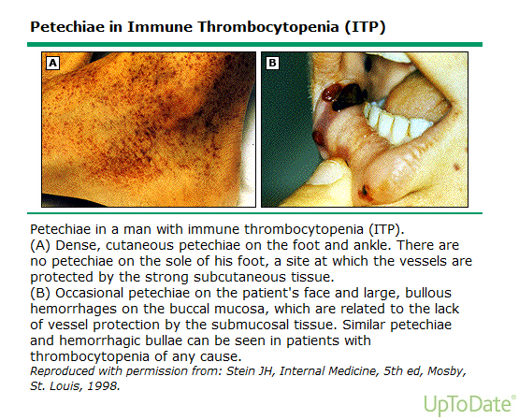

Slide 7
Clinical picture
However, thrombocytopenia does not cause massive bleeding into tissues (eg, deep visceral hematomas or hemarthroses), which is characteristic of bleeding secondary to coagulation disorders

Slide 8
Etiology
Thrombocytopenia may be due to :
1. Idiopathic (Immune) thrombocytopenic purpura.
2. Other immunologic causes : HIV , collagen vascular diseases (as SLE), lymphoproliferative disorders, drugs.
3. Heparin induced.
4. Non immunologic : Splenomegaly, Gram negative sepsis, ARDS.
5. Thrombotic thrombocytopenic purpura- Hemolytic uremic syndrome

Slide 9
Etiology
Also, etiology can be classified as follows according to the mechanism:
Decreased platelet production
Increased platelet destruction
Dilutional Thrombocytopenia
Splenomegaly or splenic sequestration

Slide 10
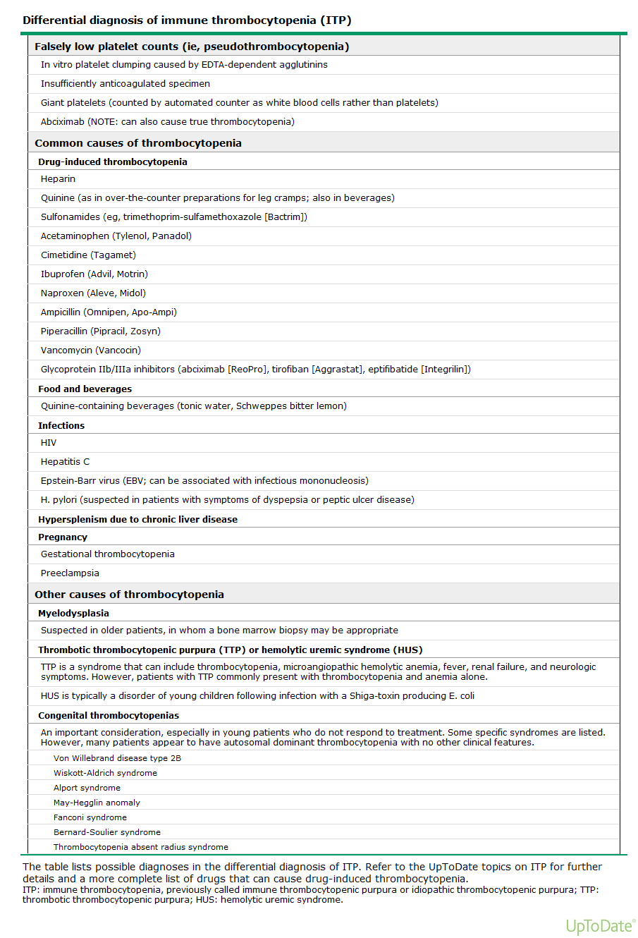

Slide 11
Decreased Platelet Production
Usually some offense that causes bone marrow suppression or damage:
Viral illness
HIV (direct damage to Megakaryocytes)
Chemo-or radiation therapy
Congenital or acquired bone marrow aplasia or hypoplasia
Vitamin B12 or Folate deficiency

Slide 12
Increased Platelet Destruction
Idiopathic (Immune) Thrombocytopenic Purpura
Alloimmune destruction; Posttransfusion, Post-transplantation
Disseminated Intravascular Coagulation
Thrombotic Thrombocytopenic Purpura
Antiphospholipid Antibody Syndrome
Certain drugs; Heparin, quinidine, valproate

Slide 13
Splenic Sequestration
Normally, ~1/3 of platelets are sequestered in the spleen in any given time
In extreme splenomegaly, up to 90% of platelets can be trapped in the spleen
Cirrhosis, portal HTN, splenomegaly can all present with apparent thrombocytopenia

Slide 14
Drugs causing thrombocytopenia
Many drugs can cause thrombocytopenia.
Some drugs like anticancer drugs and valproic acid causes dose dependent decrease in the number of platelets by myelosuppression.
Drugs may also cause thrombocytopenia by immunological mechanisms.

Slide 15
Drugs causing thrombocytopenia
Quinine and Quinidine group
Heparin : Both the Regular unfractionated heparin and LMWH
Gold salts
Antimicrobials
Antimony containing drugs as Stibophen and Sodium stibogluconate
Cephalosporins as Cephamandazole, Ceftazidime , Cephalothin .
Penicillins : Ampicillin, Apalcillin , Methicillin, Meziocillin, Penicillin , Piperacillin.
Sulpha group : Sulfamethoxazole, Sulfamethoxypyridazine, Sulfisoxazole
Ciprofloxacin
Clarithromycin
Fluconazole - Fusidic acid
Gentamicin - Nilidixic acid
Pentamidine - Rifampin
Suramin - Vancomycin

Slide 16
Drugs causing thrombocytopenia
Anti-inflammatory drugs
Salicylates , Diclofenac , Fenoprofen , Ibuprofen , Indomethacin, Meclofenamate, Mefanamic acid , Naproxen , Oxyphebutazone, Phenylbutazone , Piroxicam , Sulindac , Tolmetin .
Cardiac medications and diuretics
Digoxin , Digitoxin , Amiodarone, Procainamide, Alprenolol , Oxprenolol , Captopril , Diazoxide , Alpha-methyldopa, Acetazolamide , Chlorothiazide , Chlorthalidone , Furosemide , Hydrochlorothiazide , Sprinolactone .

Slide 17
Drugs causing thrombocytopenia
Benzodiazepines as Diazepam
Anti-epileptic drugs as Carbamazepine , Phenytoin, Valproic acid.
H2-antagonists as Cimetidine , Ranitidine .
Sulfonylurea drugs as Chlorpropamid , Glibenclamide.
Iodinated contrast agents
Retinoids as Isotretinoin , Etretinate .
Anti-histamines as Antazoline, Chlorpheniramine
Illicite drugs as Cocaine , Heroin .
Antidepressants as Amitriptyline, Desipramine , Doxepin, Imipramine, Mianserine .
Miscellaneous drugs:Tamoxifen ,Actinomycin-D, Aminoglutethimide, Danazole, Desferrioxamine, Levamizole, Lidocaine ,Morphine, Papaverine, Ticlodipine

Slide 18
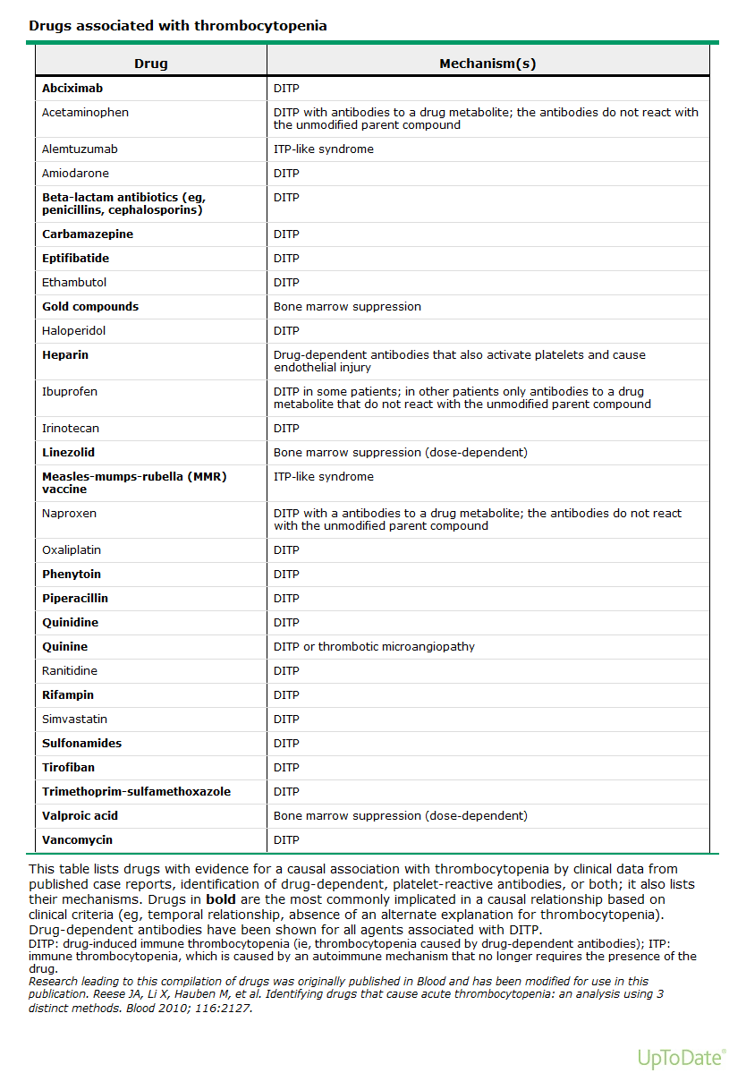

Slide 19
History
A thorough drug history must be taken to rule out exposure to drugs known to increase platelet destruction in sensitive patients.
For example, up to 5% of patients receiving heparin may develop thrombocytopenia, which may occur even with very low dose heparin (eg, used in flushes to keep IV or arterial lines open).

Slide 20
History
The history may elicit symptoms suggestive of underlying immunologic disease (eg, arthralgia, Raynaud's phenomenon, unexplained fever);
Signs and symptoms suggestive of thrombotic thrombocytopenic purpura-hemolytic-uremic syndrome (TTP-HUS);
Blood transfusion within 10 days, which may suggest posttransfusion purpura;
Significant alcohol consumption, which may suggest alcohol-induced thrombocytopenia.
Thrombocytopenia, usually mild, occurs in about 5% of pregnant women at term.
Patients with HIV commonly have thrombocytopenia, which may be clinically indistinguishable from idiopathic thrombocytopenic purpura (ITP).

Slide 21
Findings on physical examination are also important for diagnosis
Fever may be present in thrombocytopenia secondary to infection or active SLE and in TTP-HUS, but is absent in ITP and in drug-related thrombocytopenias.
The spleen is not enlarged in thrombocytopenias caused by increased platelet destruction (eg, ITP, drug-related immune thrombocytopenias), but it is palpably enlarged in most thrombocytopenias secondary to splenic sequestration of platelets or secondary to a lymphoma or a myeloproliferative disorder.
Other physical signs of chronic liver disease are important to document: eg, spider angiomas, jaundice, and palmar erythema.
Near-term pregnancy is a common cause of thrombocytopenia.

Slide 22
Laboratory
The peripheral blood cell count is key to establishing the presence and severity of thrombocytopenia, and examination of the smear provides etiologic clues.
Screening tests of hemostasis will be normal unless the thrombocytopenia is associated with another condition affecting hemostasis (eg, liver disease, disseminated intravascular coagulation).
Bone marrow aspiration may be indicated if abnormalities other than thrombocytopenia are noted on the peripheral blood smear. It provides information on the number and appearance of megakaryocytes and confirms the presence or absence of disease causing marrow failure (eg, myelodysplasia).
Measurement of antiplatelet antibodies is not clinically useful.
Tests for HIV antibody should be performed in patients whose history or examination provides evidence of risk for HIV infection.

Slide 23
Initial Diagnostic Workup
• Complete Blood Count (CBC):
- Platelet count and morphology
- Rule out pseudothrombocytopenia (clumping)
• Peripheral Blood Smear:
- Assesses platelet morphology, schistocytes in TTP
• Comprehensive Metabolic Panel (CMP):
- Evaluates liver and kidney function
• Coagulation Tests:
- PT/INR, PTT, fibrinogen (DIC, liver disease)

Slide 24
Specific Diagnostic Tests
• Autoimmune Workup:
- ANA (SLE), Rheumatoid Factor (RA)
• Infectious Workup:
- Hepatitis A, B, C
- HIV screening
• Hematologic Evaluation:
- SPEP, immunofixation (multiple myeloma)
- Bone marrow biopsy (production defect)
• Platelet Function Tests:
- Platelet antibody (immune thrombocytopenia)
- Platelet aggregation studies (if function suspected)

Slide 25
Specialized Tests
• Hemolysis Workup:
- LDH (hemolysis)
- Haptoglobin (decreased in hemolysis)
- Reticulocyte count (bone marrow response)
• Nutritional Testing:
- Vitamin B12, Folate (megaloblastic anemia)
• Imaging Studies:
- Abdominal ultrasound (splenomegaly)
• Flow Cytometry:
- For hematologic malignancies (leukemia, lymphoma)

Slide 26
Definition
This is a disease in which antibodies to platelets are produced by one’s immune system. These antibodies adhere to the platelets and cause them to be destroyed, often in the spleen.
Sometimes it is possible to identify specific diseases or drugs that cause the condition. Often, however, there is no obvious reason. In these instances the term immune or idiopathic is used.
The disease may be seen at any age but is more common in children and younger adults.

Slide 27
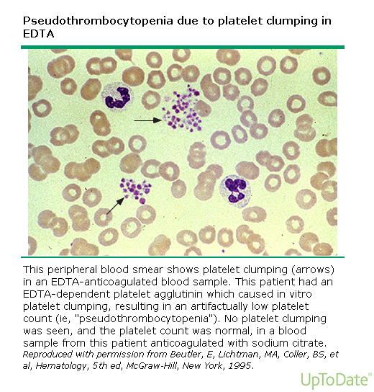

Slide 28
Treatment
Treatment of thrombocytopenia varies with its cause and severity.
The cause should be rapidly sought and identified and corrected when possible (eg, discontinuing heparin in heparin-induced thrombocytopenia).
Platelet transfusions should be used prophylactically with discretion because they may lose their effectiveness with repeated use owing to the development of platelet alloantibodies.
If thrombocytopenia is caused by increased platelet consumption, platelet transfusions should be reserved for management of life-threatening or CNS bleeding.
If thrombocytopenia is caused by marrow failure, platelet transfusions are reserved for management of active bleeding or severe thrombocytopenia (eg, platelet count <10,000/µL).

Slide 29
Management Strategies
• Immune Thrombocytopenia (ITP):
- First-line: Corticosteroids, IVIG
- Second-line: Rituximab, splenectomy
• Thrombotic Thrombocytopenic Purpura (TTP):
- Plasma exchange, corticosteroids
• Disseminated Intravascular Coagulation (DIC):
- Treat underlying cause, supportive care
• Platelet Transfusion:
- Indicated for severe thrombocytopenia with bleeding.

Slide 30
IMMUNE THROMBOCYTOPENİA

Slide 32
Immune thrombocytopenia in adults
There are a number of differences:
1. It is much more likely to be caused by a drug or an underlying disease, such as lupus. Sometimes that disease may not be obvious until later.
2. More often, the disease does not get better and is therefore chronic.
3. The disease is more frequently relapsing.
4. It often does not respond as well to treatment as in children.

Slide 33
Treatment
Steroids: Prednisolone 1mg/kg
Gammaglobulin can be used, but it will not cause improvement in as high a percentage of patients as it does in children.
Splenectomy helps in 50 to 75 percent of patients; however, there is no good way to predict, before the surgery, who will benefit.
Rituximab (anti CD 20 monoclonal ab)
Some chemotherapy drugs, such as Cylophosphamide, Imuran and Vincristine, as well as male hormones (androgens) have worked in cases that do not respond with other treatment.
Occasionally nothing works very well, and the platelet counts stays down. Fortunately, even with very low counts, most people escape serious bleeding problems.

Slide 34
Choosing Wisely in Thrombocytopenia
• Avoid unnecessary platelet transfusions if counts >10,000/µL without bleeding.
• Do not perform routine bone marrow biopsies unless clinically indicated.
• Consider medication-induced causes before extensive workup.
• Limit repeat testing if platelet counts are stable.
• Utilize evidence-based thresholds for interventions.

Slide 35
Conclusion
• Thrombocytopenia requires a thorough diagnostic approach.
• Initial testing should guide further workup.
• Treatment depends on the underlying cause.
• Avoid unnecessary interventions through evidence-based practices.

